Slide 1
Movie Reviews Sentiment Prediction and Topic Modeling
Group Members: Yingying Qian, Xiao Xiao, Qingnan Wang, Hanchen Liu, Runfeng Zhang

Slide 2
Table of Contents
Problem Statement
Sentiment Prediction
Logistic Regression
RNN & LSTM
Hugging Face 🤗
Model Implementation
Business Use Case
Topic Modeling
Return on Investment

Slide 3
Problem Statement
Data Scientist Team at Warner Brothers
Task 1
WB has released some movies recently. However, currently we do not have enough movie reviews on the movies review website so we are not sure about how our audience react to the movie. However, there are a lot of reviews posted on the social media (Twitter, Facebook, etc.) and we have already scrapped these reviews. We want to DS team to help us build models to predict audience sentiment.
Task 2
Topic models can help us analyze the movies that are discussed by our audience. By doing topic modeling, we know the hot topics about movies, which are useful to our marketing strategies. By analyzing these topic, we can make better decision on future movie topics. Besides, we can classify the reviews by different topics. Then users can easily find the reviews of the topics that they are interested in.

Slide 4
Problem Statement
Datasets we use: IMDB dataset having 50K movie reviews. It contains 25,000 highly polar movie reviews for training and 25,000 for testing, which is a good dataset for building sentiment classification models.
Sentiment Prediction
Topic Modeling
By training classification models using the IMDB movie reviews dataset, we can predict the underlying sentiment of movies reviews collected from social media
Using the IMDB movie reviews, we can find out different topics these reviews cover and group them by those topics. Then, do some analysis to make decision on future movie topics.

Slide 5
Sentiment Prediction: Logistic Regression
Data Preparation
Remove HTML tags and punctuation using Regex
Stemming
Model Building
Tokenized text using both Count Vectorizer, TFIDF Vectorizer and Spacy
Split training (37500 reviews) and testing dataset (12500 reviews)
Train Logistic Regression model
Accuracy on testing set:
Count Vectorizer | TFIDF Vectorizer | Spacy
85.2% | 85.2% | 85.6%

Slide 6
Sentiment Prediction: RNN & LSTM & Hugging Face
RNN & LSTM
Stopwords removal using Spacy
Tokenized Text using tokenizer by keras.preprocessing.text, num_words=5000
Encoded documents and padded sequence length
max sequence length = 150, decided using histogram and percentiles statistics
Train test split: test = 0.2
Used glove6b100d vectors
Hugging Face
Tokenized Text using BertTokenizerFast
Predict sentiment with a pretrained model ‘sentiment-analysis’ using pipeline
LSTM | RNN | Hugging Face
87.4% | 67.6% | 82%

Slide 7
Model Implementation
Model Summary
LR using Count Vectorizer | 85.2%
LR using TFIDF Vectorizer | 85.2%
LR using Spacy | 85.6%
LSTM | 87.4%
RNN | 67.6%
Hugging Face | 82%
How we implement this model in the future
We could find that LSTM achieved highest accuracy. In the future, for all movies that have released for only a small period of time, we can scrape reviews from social media, and then use the preprocessing pipeline to clean these reviews, and finally apply the pre-trained LSTM model to predict sentiment of each review. We expect this model can classify sentiment of reviews with more than 85% accuracy. In addition, we will re-train this model monthly using more reviews collected in hope to increase prediction accuracy.

Slide 8
Business Use Case
Application of Sentiment Prediction
Marketing Budget Optimization
Average cost of a movie
Marketing/Advertising Strategies
Adjust marketing strategies of each movie timely based on early stage review sentiment.
$ 65 million
Production Cost
Media Monitoring
$ 35 million
Marketing and distribution Cost
In the future, we can build an automate media monitoring process to track audience reaction to the movie overtime, and monitor mentions or reviews of the movies on different platforms.
By predicting sentiment at the early stage of a movie release, we can adjust and optimize our marketing spendings based on audience reactions, and thus generate a higher return on advertising budget.

Slide 9
Topic Modeling
Our goal is to find out the topics of the reviews. So we need to remove words about sentiments. We also need to remove some verbs and adverbs that has no relationship to topics of reviews.
So , we update stopwords here.
Step 1: Add New Stopwords
Step 2: Vectorize the Corpus
Step 3: Fit NMF Model
Step 4: Report Results for Each Topic
Step 5: Get the Top Documents for Each Topic
Step 6: WordCloud for Each Topic
Examples:
Words about sentiments: "worst","bad","good", "better", "like", "great", "best", "ever", "seen", "waste", "wast", "time", "money", "well", "worth", "recommend"...
Adverbs and conjunctions: "really", "even", "though", "although", "highly"...

Slide 10
Topic Modeling
Then we vectorize the corpus using TFIDF.
We tried ngram=2 and ngram=3 and we found ngram=3 can bring us more meaningful results.
Although infrequent words are useful for us to analyze the texts, they may be less useful in topic modeling because we want to find topics in common. “min_df=10” can help us keep the tokens appear at least 10 times.
“max_df=0.4” help us get rid of common words appear in too many (more than 40% of) documents.
Step 1: Add New Stopwords
Step 2: Vectorize the Corpus
Step 3: Fit NMF Model
Step 4: Report Results for Each Topic
Step 5: Get the Top Documents for Each Topic
Step 6: WordCloud for Each Topic

Slide 11
Topic Modeling
We tried different numbers of topics and found 5 is reasonable. We get the top documents for each topic to better explore the 5 topics.
Here are top tokens for each topic:
Step 1: Add New Stopwords
Step 2: Vectorize the Corpus
Step 3: Fit NMF Model
Step 4: Report Results for Each Topic
Step 5: Get the Top Documents for Each Topic
Step 6: WordCloud for Each Topic
TOPIC 0
new york citi (58.9%)
live new york (1.8%)
street new york (1.6%)
set new york (1.0%)
citi new york (1.0%)
TOPIC 1
world war ii (64.4%)
post world war (1.9%)
save privat ryan (1.3%) kristin scott thoma (1.3%) sit back enjoy (0.8%)
TOPIC 2
base true stori (69.7%)
stori base true (1.1%) real life stori (0.7%) top notch perform (0.6%)
dream come true (0.6%)
TOPIC 3
sci fi channel (53.6%)
fi channel origin (3.2%) john rhi davi (1.8%) made sci fi (1.7%)
horror sci fi (1.7%)
TOPIC 4
texa chainsaw massacr (21.2%)
low budget horror (14.8%)
blair witch project (7.0%)
night live dead (2.6%)
budget horror flick (2.0%)

Slide 12
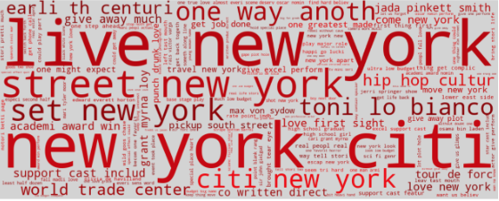
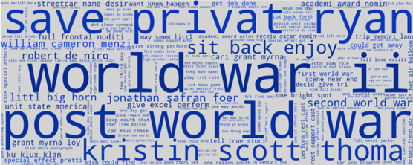
Topic Modeling
Topic 0:
The reviews in topic one are those about New York. Besides tokens of NY and NYC, we can also find something like “World Trade Center” that are related to NYC.
Step 1: Add New Stopwords
Step 2: Vectorize the Corpus
Step 3: Fit NMF Model
Step 4: Report Results for Each Topic
Step 5: Get the Top Documents for Each Topic
Step 6: WordCloud for Each Topic
Topic 1:
This topic is about Wars, especially world war II. We can also see some actors’/actresses’ names such as Kristin Scott Thomas, who appeared in movies about WWII (eg. Suite Française).

Slide 13
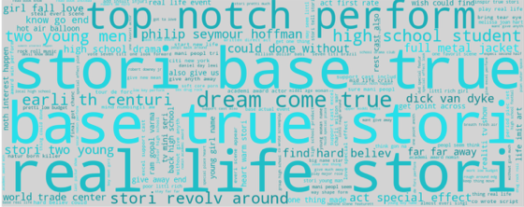
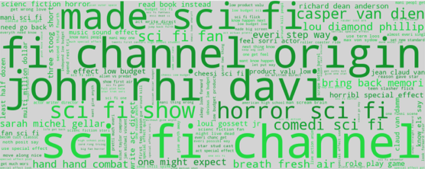
Topic Modeling
Topic 2:
This topic is about the movies based on true stories. We can also find tokens about the characters such as “two young men” and “high school student” in the stores.
Step 1: Add New Stopwords
Step 2: Vectorize the Corpus
Step 3: Fit NMF Model
Step 4: Report Results for Each Topic
Step 5: Get the Top Documents for Each Topic
Step 6: WordCloud for Each Topic
Topic 3:
This topic is about fictions, especially science fictions. We can also see a name – John Rhys-Davies, who portrayed Gimli in The Lord of the Rings trilogy.

Slide 14
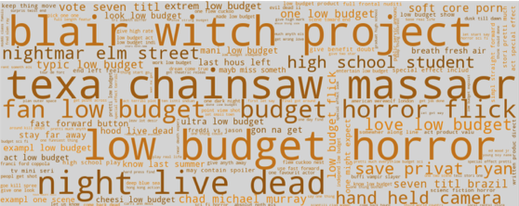
Topic Modeling
Step 1: Add New Stopwords
Step 2: Vectorize the Corpus
Step 3: Fit NMF Model
Step 4: Report Results for Each Topic
Step 5: Get the Top Documents for Each Topic
Step 6: WordCloud for Each Topic
Topic 4:
This topic is about horror movies. We can see names of horror movies like Texas Chainsaw Massacre and The Blair Witch Project.
Many horror movies are low-budget movies so we can see many tokens about budget here.
Besides, words that are related to horror movies also appear, such as “nightmare”.

Slide 15
Return on investment
Cost:
Assume an experienced data scientist takes a total of 1 month of time on this model (including model building, modeling tuning, building and maintaining pipelines, etc)
Assume his annual salary is $180,000 per year. That’s $15k per month
Assume other cost such as HR support, hiring cost, etc. totaled 1k per month
Benefit
The result of this project can help movie producer to target the right audience better and utilize their advertising budget better
Average movie box office pre-covid is $12,426,863 (in 2019)
If the result can increase 1% increase in box office revenue, the producer gains $124,268 of extra evenue
Net
108k of net gain
The return on investment is 675%

